Slide 1
TASK-1
Cross Site Scripting
Vulnerability
-Vijayalakshmi.S

Slide 2
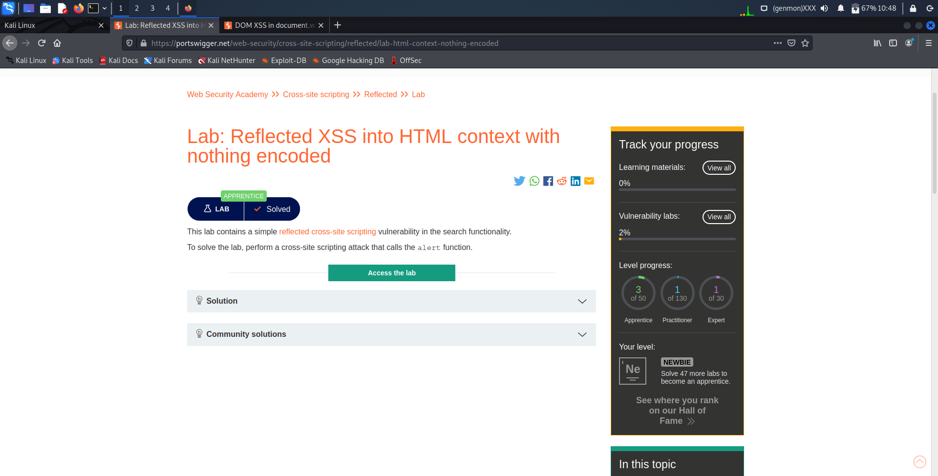

Slide 3
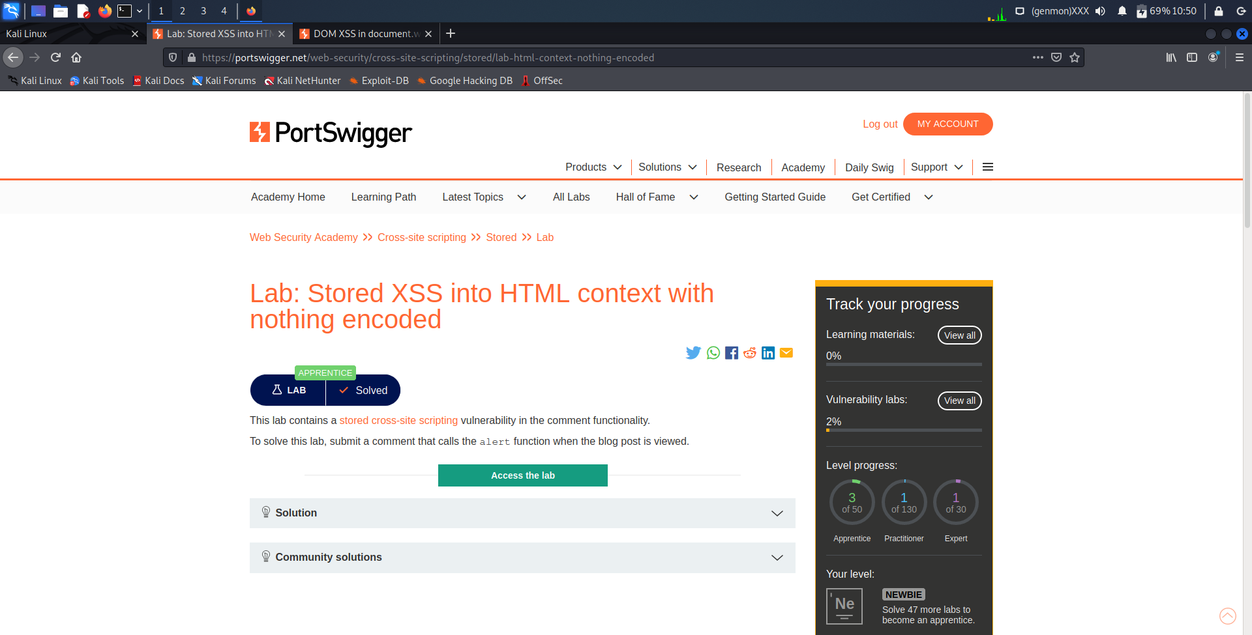

Slide 4
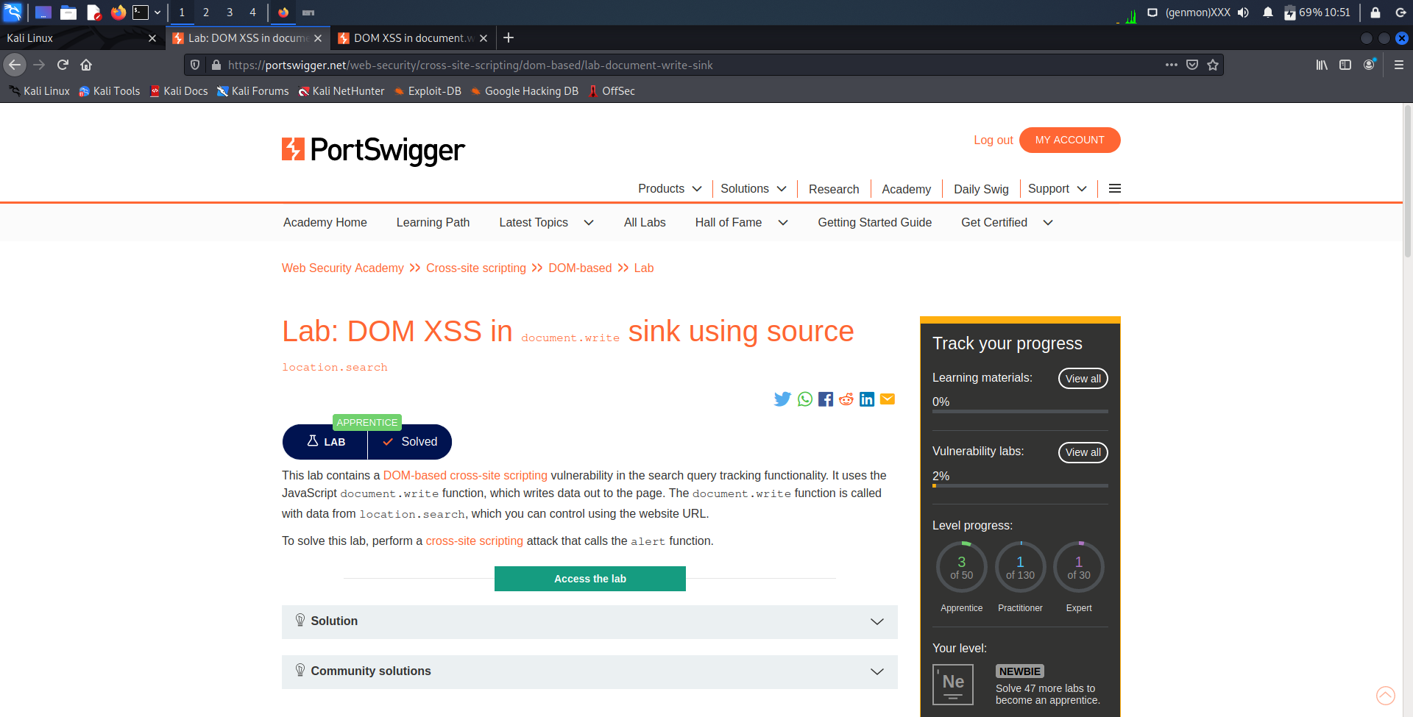

Slide 5
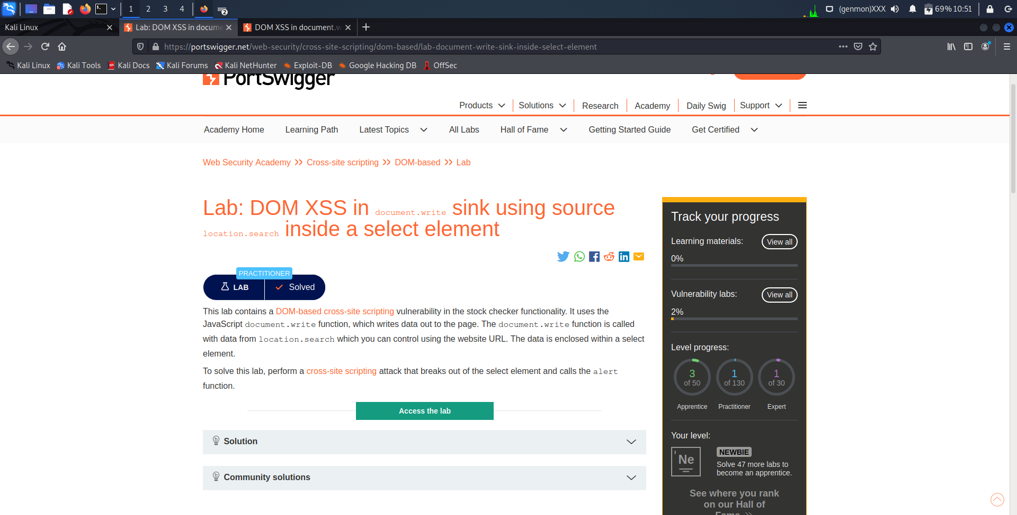

Slide 6
